Slide 1
Building a resilient IaaS architecture
Notes:
March 2020

Slide 2
Abstract and learning objectives
In this whiteboard design session, you will look at how to design for converting/extending an existing IaaS deployment to account for resiliency and in general high availability. Throughout the whiteboard design session, you will look at the various configuration options and services to help build resilient architectures.
At the end of the workshop, you will be better able to design and use resiliency concepts including High Availability with protection from hardware/rack failures with Availability sets, High Availability and Disaster Recovery for database tiers using SQL Always ON, Disaster Recovery for virtual machines to another region using Azure Site Recovery to meet RTO and RPO goals, and data protection using Azure Backup.

Slide 3
Step 1: Review the customer case study
Outcome
Analyze your customer needs.
Timeframe
15 minutes

Slide 4
Customer situation
Contoso Inc. is a leading manufacturer, seller, distributor, and servicer of parts for Heating, Venting and Air-Conditioning (HVAC) systems. Their customer base includes some of the largest corporations and independent firms in the US.
Contoso specializes in the datacenter space, designing computer room air conditioning (CRAC) units and contracting in the planning of hyper-scale cloud provider datacenter cooling strategies. As such, the Research and Development group is one of the largest business units in the company.
Headquarters is in Cheyenne, Wyoming with a secondary location in Seattle, Washington.
Notes:
Contoso Inc. manufactures, sells, distributes, and services parts for major appliances and HVAC systems for large corporations and independent firms. The ordering system is currently housed in Azure on IaaS SQL server instances. Initially, the ordering process was done mainly via phone and expanded to email. Recently, the company has moved to an internet based ordering system with IIS Web Servers in Azure housing the front-end application for the ordering, invoicing, and support options.
They have grown into a viable, sustainable business and would like their technology to mirror the growth and sustainability. This would help cement their reputation in the industry and go a long way to assist their future growth. While business impact analysis (BIA) has not officially been performed, they have an overall plan of wanting to restore from an issue within 4 hours and recover to within the last 8 hours if at all possible.
There is no overall IT shop for Contoso Inc. as such. They are pretty much a classic IT company that does not have deep experience in the interactivity of all the
components. They have rolled out sections and departments successfully, but now as the technology matures, they are in need of guidance for their deployments.
Currently, there are 3 branch offices located throughout the U.S. One is in the mid-West, another is on the East Coast and the third is located on the West Coast. Discussions are in progress to grow the business to Europe and a possibility of factories in Mexico and Asia.
Each branch office is small enough that there are no servers housed on-site. Each location has direct connectivity to corporate resources through a VPN connection to the Austin headquarters. Email is accessed via web as is the main ordering application.
At times, various branch offices have experienced connectivity issues due to the internet service provider having issues with the corporate office connection. While there is some understanding of these occurrences, there is a desire to provide a way to resolve this as growth continues. Employees work from home when this occurs.

Slide 5
Customer situation - continued
Contoso IT group is a classic shop, mainly focused on infrastructure.
The AppDev department’s skill set is dated, predominantly focused on client/server development.
The organization has an Internet-based ordering system they recently deployed into Azure. Customers have complained at times of intermittent problems/errors with the website.
They have a legacy application that has its data tightly coupled to the ordering system and this application cannot be changed.

Slide 6
Customer situation – continued
Recent stability issues with the ordering system prompted Contoso to perform a business impact analysis of the application. This exercise resulted in an executive mandate for a four-hour recovery time to within the last eight hours of data.
Network connectivity issues between the branch offices and the corporate office have occurred intermittently.
Disk storage has a heightened level of attention due to a critical server running out of disk space. This issue highlighted a gap in proactive monitoring.

Slide 7
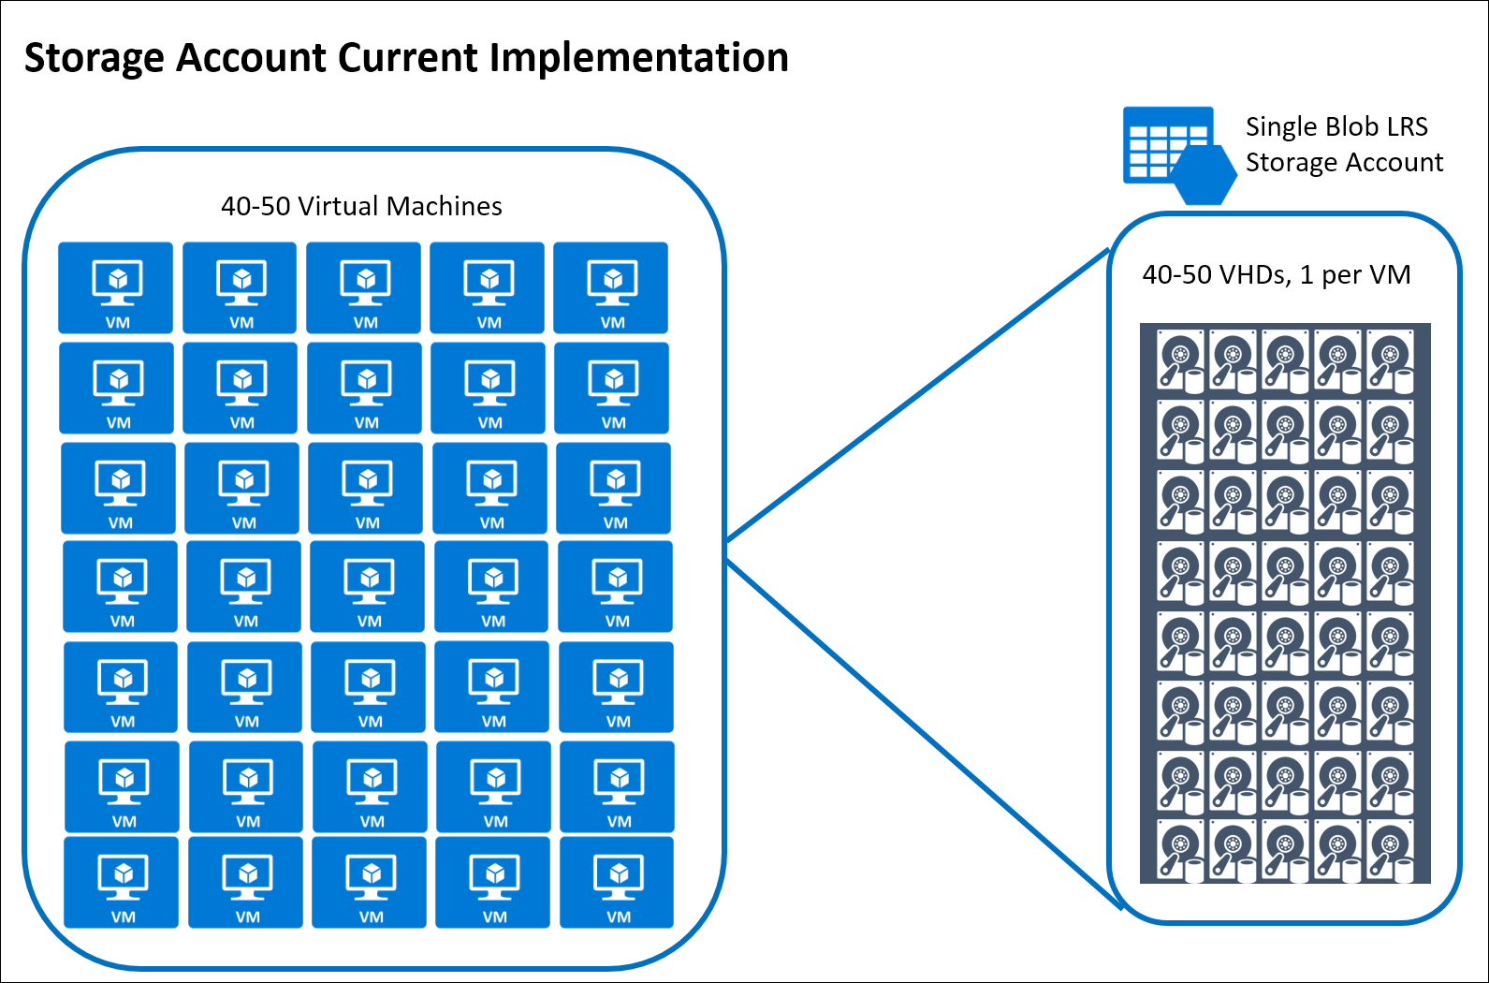
Marketing department
The Marketing department has recently been tasked with moving their server workloads into Azure by rebuilding each application.
They have begun building their servers utilizing a single Azure storage account. They have around 40-50 VMs already but anticipate continued growth.

Slide 8
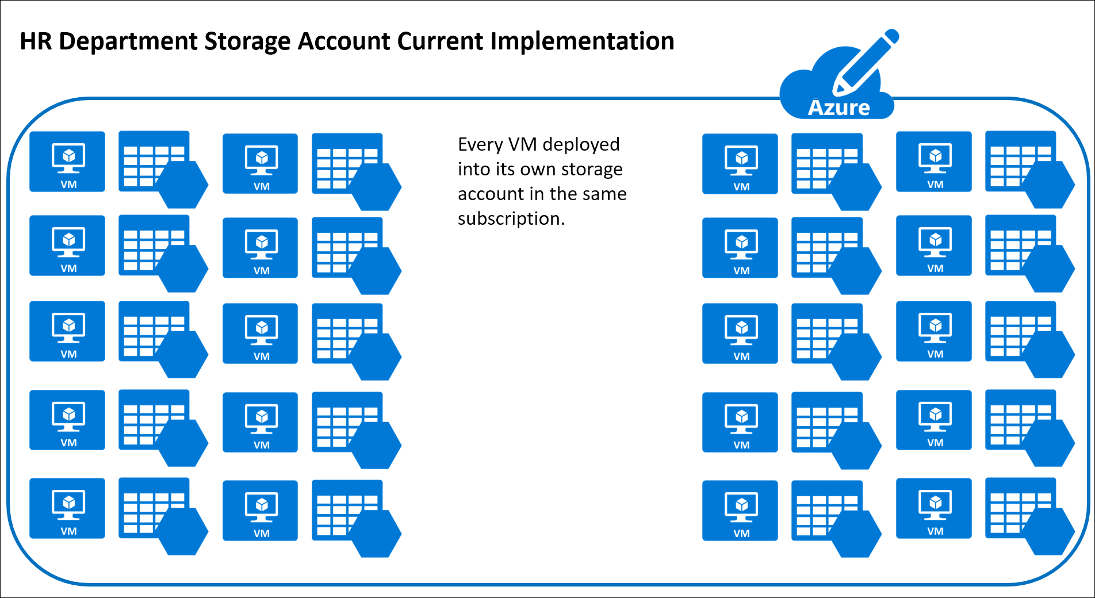
Human resources (HR)
HR is asking IT to move workloads to Azure and several have already begun.
Existing policy to create a new storage account for each VM in their subscription.

Slide 9
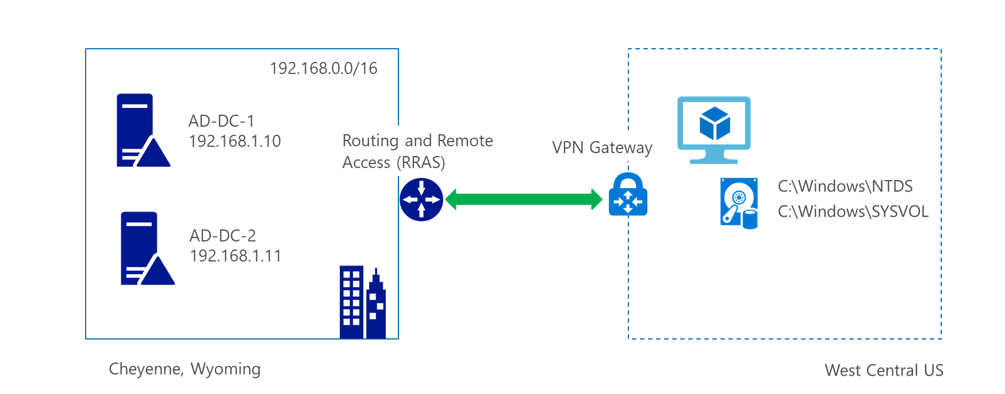
Current Active Directory Configuration
Currently have a single domain controller deployed in west central US.
Connectivity is enabled with a site-to-site VPN gateway.

Slide 10
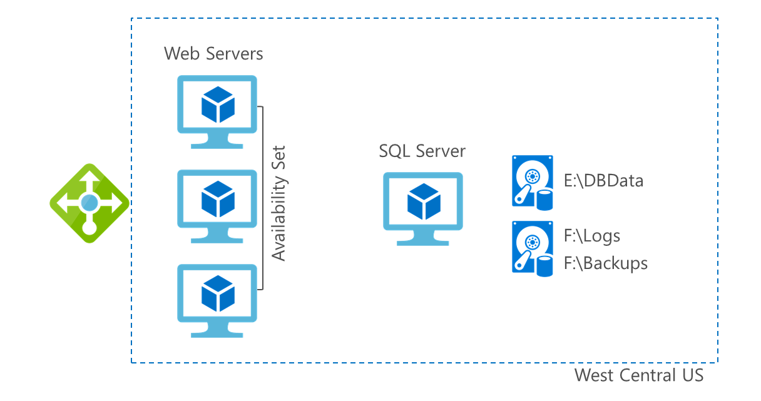
Current configuration for ordering application
Web servers deployed into an availability set
SQL Server backend
West central US

Slide 11
Customer needs
The IT department is using outdated guidance on Azure and they need updated guidance on current architectural and deployment best practices.
They need assistance with enabling connectivity and authentication for new infrastructure that will be deployed for the Seattle office.
Identify the infrastructure requirements that should to be configured to provide redundancy and resiliency to the web servers and the database servers for the ordering application in order to protect them from system downtime and/or region wide outage.

Slide 12
Customer needs - continued
An automated mechanism for a quick recovery of the ordering application in the event of disaster.
A plan for recovery from data corruption or accidental deletion for all of the other infrastructure.
A functional storage policy in place for the anticipation of growth in Azure.
Monitoring option for issues that may arise on the servers and in Azure.

Slide 13
Customer objections
Cost is a huge concern for us. With looming infrastructure and server replacement costs, we want to avoid any unnecessary expenditures.
Downtime is becoming more of an issue for us due to development and production environments not being separate. We need to separate these from one another to avoid outages.
Connectivity is becoming an issue for self-hosting our application’s ordering system, support website, etc. We are concerned that the cloud may be constrained as well.

Slide 14
Customer objections - continued
We are very concerned about the disk space issue that occurred earlier with our ADDS DCs and nearly our Web Servers and Database Servers. Will this be addressed per the resiliency plan?

Slide 15
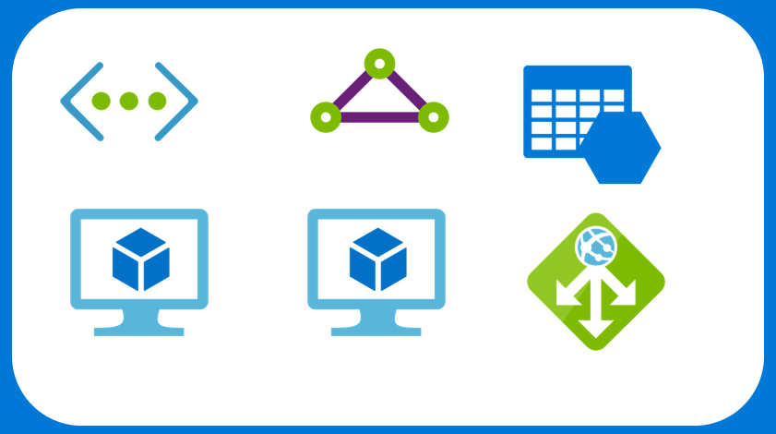
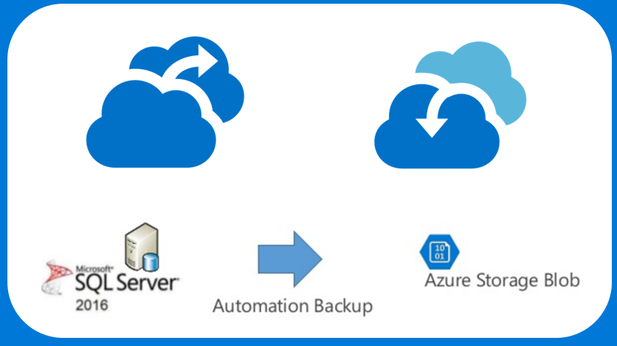
Common scenarios – Infrastructure as a Service
Azure Infrastructure as a Service (IaaS)
Backup and Business Continuity
Virtual Machines
Virtual Networks
VPN Gateways
Azure Backup
Hybrid Connectivity
Load Balancers
Storage
Azure Site Recovery
SQL Server Managed Backup

Slide 16
Step 2: Design the solution
Outcome
Design a solution and prepare to present the solution to the target customer audience in a 15-minute chalk-talk format.
Timeframe
60 minutes
Business needs (10 minutes) | Respond to questions outlined in your guide and list the answers on a flipchart.
Design (35 minutes) | Design a solution for as many of the stated requirements as time allows. Show the solution on a flipchart.
Prepare (15 minutes) | Identify any customer needs that are not addressed with the proposed solution. Identify the benefits of your solution. Determine how you will respond to the customer’s objections. Prepare for a 15-minute presentation to the customer.

Slide 17
Step 3: Present the solution
Outcome
Present a solution to the target customer in a 15-minute chalk-talk format.
Timeframe
30 minutes (15 minutes for each team to present and receive feedback)
Directions
Pair with another table.
One table is the Microsoft team and the other table is the customer.
The Microsoft team presents their proposed solution to the customer.
The customer asks one of the objections from the list of objections in the case study.
The Microsoft team responds to the objection.
The customer team gives feedback to the Microsoft team.

Slide 18
Wrap-up
Outcome
Identify the preferred solution for the case study.
Identify solutions designed by other teams.
Timeframe
15 minutes

Slide 19
Preferred target audience
Lewis Franklin, Head of Infrastructure and Operations
Richard Wade, Infrastructure Lead
Tony Stark, Research and Development Group Director
Janet Lewis, Business Continuity Team Director

Slide 20
Preferred solution
The solution for Contoso Inc. involved several technologies, including:
Site-to-Site VPN Gateway for connectivity from on-premises corporate home office and branch office locations in Azure virtual networks.
Peering for connectivity between the West Central US and West US 2 Azure Regions.
Resiliency integrated into each aspect of the deployment and architecture to provide the opportunity for high SLA and performance. These include:
The use of managed disks to alleviate Contoso’s management of storage accounts.
Legacy application deployed to Azure in a VM with premium storage (necessary to achieve 99.9% SLA), backed up with Azure Backup and replicated across region via Site Recovery.
Backup vaults in each of the Azure regions to provide backups for the servers.
Redundant VPN Gateway connectivity in Azure and on-premises
Redundant domain controllers in both regions.
Replication of the web tier to secondary region with Site Recovery.
SQL Always On Availability Groups with SQL Managed Backup to Azure Storage.
Orchestration for recovery using Site Recovery – Recovery Plans

Slide 21
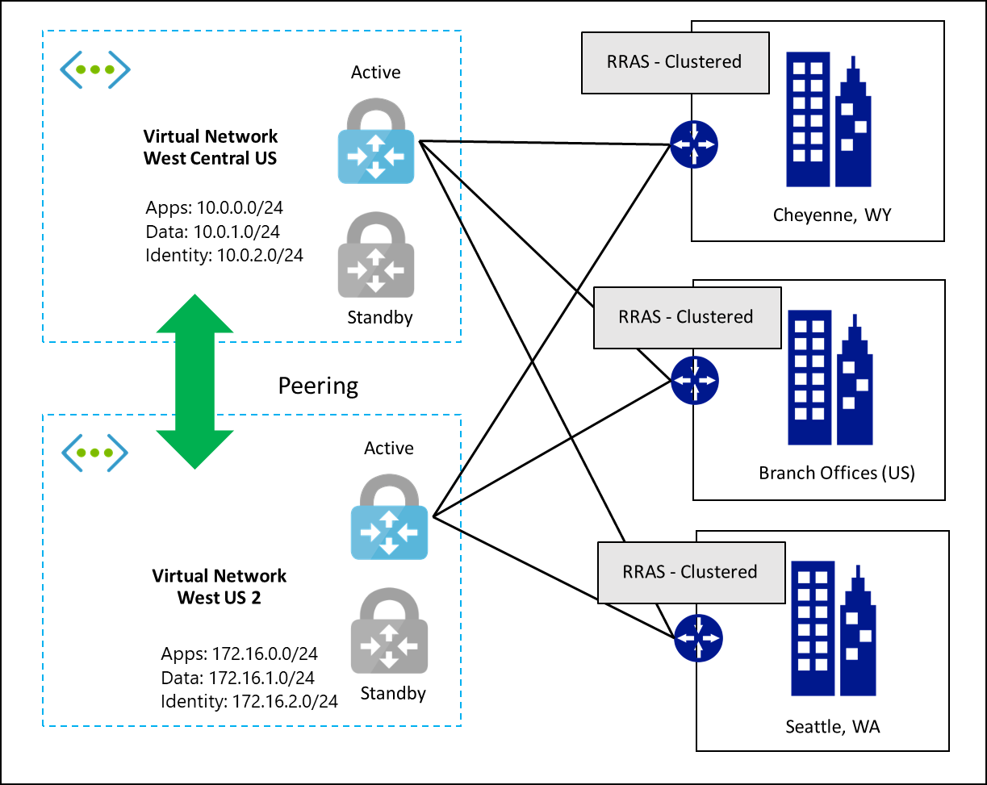
Recommended solution for virtual network design
Peering for connectivity between the west central US and west US 2 Azure regions
Redundant VPN connections from each data center and branch office (BGP requirement)
Windows Server clustering used for high availability on-premises
Notes:
You need to create multiple S2S VPN connections from each on-premises VPN device to Azure. When you connect multiple VPN devices from the same on-premises network to Azure, you need to create one local network gateway for each VPN device, and one connection from your Azure VPN gateway to the local network gateway.
The local network gateways corresponding to your VPN devices must have unique public IP addresses in the "GatewayIpAddress" property.
BGP is required for this configuration. Each local network gateway representing a VPN device must have a unique BGP peer IP address specified in the "BgpPeerIpAddress" property.
The AddressPrefix property field in each local network gateway must not overlap. You should specify the "BgpPeerIpAddress" in /32 CIDR format in the AddressPrefix field.
You should use BGP to advertise the same prefixes of the same on-premises network prefixes to your Azure VPN gateway, and the traffic will be forwarded through these tunnels simultaneously.
Each connection is counted against the maximum number of tunnels for your Azure VPN gateway, 10 for Basic and Standard SKUs, and 30 for HighPerformance SKU.

Slide 22
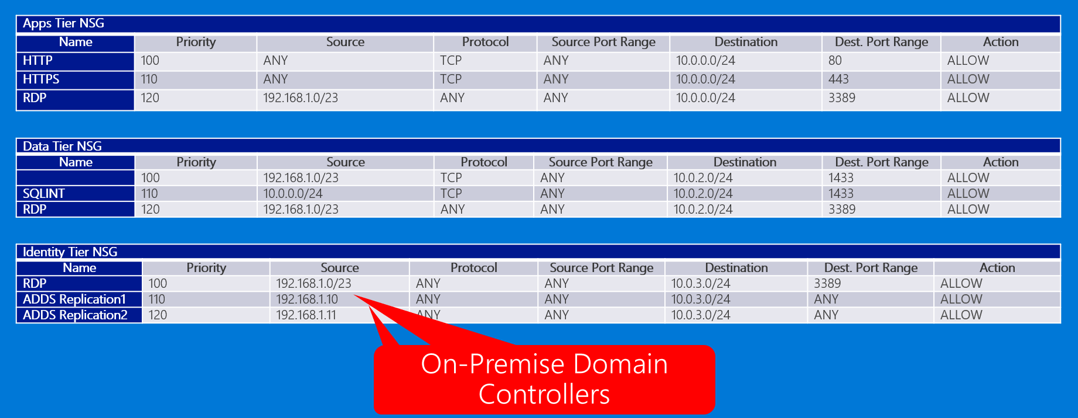
Network Security Group usage (West Central)
Network security groups (NSGs) will be used to help secure the configuration by limiting traffic flow exactly as a firewall rule does. NSGs may be applied to either individual NICs or to Subnets. In Contoso’s case there will be a single NSG applied to each subnet.

Slide 23
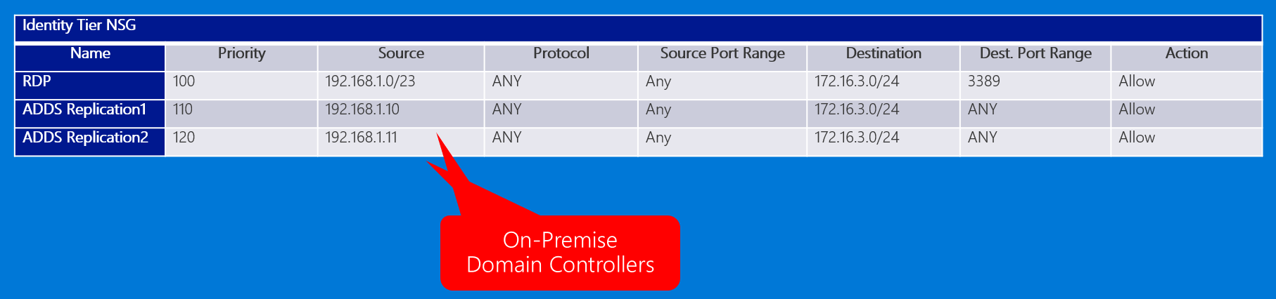
Network Security Group usage (West US 2)
Since Contoso has not deployed any additional infrastructure to West US 2 the only ports needed are for administration and replication of Active Directory.

Slide 24
Recommended solution for Active Directory
Azure Backup to protect the VMs
Storage configured for resiliency
Domain controllers deployed into availability sets in Primary region and into Availability Zones in Secondary region.
All 4 DCs are active for DR strategy.
Notes:
Active Directory Domain Service (ADDS) Domain Controllers (DC) are deployed into Azure virtual machines. These are extensions of the on-premises AD DS DCs and allow for resiliency for the authentication and authorization mechanism that Litware employees use today.
Configure multiple VMs as Domain Controllers in the West Central U.S. region and two others in the West US 2. ADDS Sites and Services will be configured with the two Azure regional virtual networks as new sites in AD.
Each Domain Controller will be configured with a Data Disk for the ADDS database and will be configured to back up via Azure Backup for disaster recovery and business continuity. To avoid any issue with the ADDS DB, this data disk needs to be configured with caching set to NONE.
Storing the AD files on a data disk with caching set to None will keep the ADDS database and SYSVOL from any potential corruption due to caching.
Adding DCs into an availability set will spread them across fault domains and update domains so that authentication and authorization servers are highly available.
Deploying multiple DCs in multiple regions allows for redundancy in each region in the event of a regional Azure issue.
Replication across regions also allows for disaster recovery should the need arise and faster recovery of the ADDS database.
Removing the DC that is not in an availability set helps avoid a single point of failure for that VM.
Using Azure Backup, even with the caveats on restoring, allows for another layer of redundancy for recovery options.

Slide 25
Recommended solution for Order Application
TCP Probe replaced with HTTP
Replication to a second region with ASR to protect against regional outages
SQL Server configured with SQL Server Always On Availability Groups
SQL is backed up to Azure storage using SQL Server Managed Backup
Tip: A cloud witness is used in place of a Witness VM
Notes:
Web Server configuration details
The IIS Web Servers will be configured in the Apps Subnet and built on VMs. To help manage the load and provide performance options, the servers will be deployed into a Scale Set within Azure. This will allow Litware the option to scale-up, scale-out, and even scale-down and scale-in based on the need. It will cease Litware’s practice of scaling manually as it is rife with issues and lacks the automated scaling that can be provided otherwise for resiliency.
Litware’s use of an Availability Set for the Web farm VMs should be applauded. Availability Sets provide protection and resiliency against unplanned and planned downtime. We configured the availability set to spread the VMs across three fault domains and five update domains.
A change of the Health Probe on the Load Balancer to use an HTTP health probe rather than a TCP probe is wise. The HTTP probe will monitor for HTTP code 200, indicating a healthy web site. If anything, other than a 200 is detected (such as the HTTP 500 the customers experienced), then that server will be removed from the rotation until the site is deemed healthy again.
The web tier does not need to be backed up. When a new instance of the scale set is deployed it will automatically deploy the application from a source repository.
Resilient benefits:
Moving the Health Probe from TCP to HTTP on the load balancer gives a deeper more application centric view into the web server health. It will help avoid any intermittent problems that customers experienced in the past.
Providing Scale Sets for the Web farm deployment allows for configurable scaling (up and down) based on Litware’s desires. It allows for this to occur automatically without manual intervention and will help with the issue of deploying manually and then typically not remembering to remove the extra servers when they are no longer needed.
Scale Sets are automatically deployed into availability sets so the servers as they scale will be spread across update and fault domains via the Azure fabric.
SQL Always-On configuration details
SQL Server is critical to the availability of the applications at Litware. SQL will be implemented using a total of three Servers configured using Always-On Availability Groups. The two servers in West Central US comprise a single primary and a secondary, synchronously replica of the database. The two SQL servers will be deployed into an Azure availability set and are configured behind an internal load balancer which will allow client machines to connect to the listener which will direct traffic to the machines that is designated as the primary replica machine.
The SQL Servers will use premium managed disks with a database and log files on separate disks. The TempDB will be housed on the local host SSD drive and split to match the number of cores in the VM.
SQL Servers will have three drive letters: C:\, F:\ and G:\
NOTE: Never use the E:\ drive on an Azure VM as some Azure Regions have Host machines that contain DVD Drives.
SQL Server Managed Backup to Microsoft Azure manages and automates SQL Server backups to Microsoft Azure Blob storage. You can choose to allow SQL Server to determine the backup schedule based on the transaction workload of your database. Or you can use advanced options to define a schedule. The retention settings determine how long the backups are stored in Azure Blob storage. SQL Server Managed Backup to Microsoft Azure supports point in time restore for the retention time period specified.

Slide 26
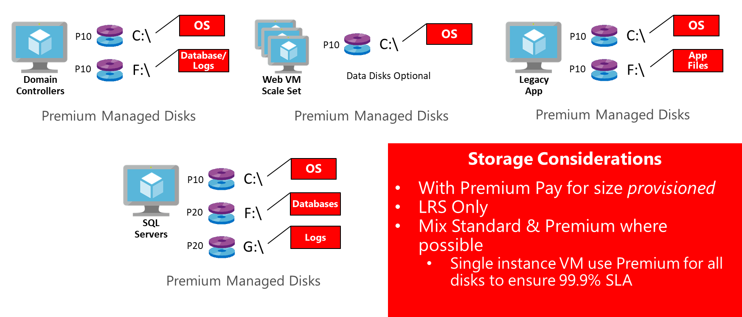
Preferred storage approach
Notes:
Moving beyond using only one storage account is a must for Contoso. The sub-optimal storage configurations at Contoso, such as 40 disks in a single storage account, or creating a single storage account per VM disk, are solved using managed disks. Managed disks remove the scalability limits associated with storage accounts, leaving the number of disks per subscription as the only remaining scale consideration.
Managed disks only are available with the LRS resiliency option; however, the lack of platform replication is mitigated:
Enabling replication to Secondary region West US 2 using Azure Site Recovery
Utilizing application-level replication (AD and SQL)
Azure Backups of IaaS VMs, SQL and System State data

Slide 27
Legacy application availability
The existing legacy application cannot be moved into an availability sets as it is based on only one VM. As a result, the best way to ensure its availability is to run it with Premium storage. Azure introduced single instance SLA’s for VM’s, so moving this application across to Azure would now result in a 99.9% SLA. As the existing hardware on which it is currently deployed on site is aging, moving this application would benefit from reduced hardware expenditure through a refresh.
The application will eventually require a re-write to take advantage of the advanced features available in Azure. This could be done once the application was in Azure.
To be able to achieve the SLA provided in Azure, the disks used for the VM must be premium storage disks. There is a limitation on Azure premium storage accounts such that they only support LRS. As such a mechanism to copy the blob across to another region needs to be setup. This can be achieved with Site Recovery disaster recovery solution. A backup of the VM will also need to be scheduled.

Slide 28
Subscription and service limitations
Contoso should be educated on the key subscription limits that they may encounter, but also be aware of how to find the documentation for these limits because they change often.
The documentation can be found here:
https://docs.microsoft.com/en-us/azure/azure-subscription-service-limits

Slide 29
Monitoring configuration details
Azure Alerts
Contoso could use Azure Alerts to raise awareness to Contoso staff when an issue occurs such as the VM being restarted, deleted, or any other action they want to be made aware of.
Log Analytics
In Contoso’s situation, they would use Log Analytics to monitor the state of the servers such as the issue mentioned about the Active Directory Domain Controller running out of disk space. A query could be made based on the % Free Space performance counter and an alert raised based on the percentage available.
Network Watcher and Azure Automation
To monitor the status of their VPN Gateway and other network health, Contoso should enable Azure Network Watcher. Network Watcher can monitor the status of their VPN Gateway, and an Azure Automation runbook could be scheduled to check the status and report on issues.

Slide 30
Customer objections
Objection
Cost is a huge concern for us. With looming infrastructure and server replacement costs, we want to avoid any unnecessary expenditures.
Potential answer
Contoso can restructure the way IT budgets are spent and ultimately save funds by rolling out the infrastructure into Azure as opposed to rolling out the infrastructure in the Cheyenne office. By building out the infrastructure in Azure there is no upfront capital investment. The cost moves to an operating expense in a pay only for what you need and use model. This frees up Contoso’s capital for other investments which are more strategic to the growth of the company. This is also done in a more professional way in that Azure datacenters are world-class, enterprise-level datacenters providing a server environment that Contoso could never build on their own. Also, deploying VMs in Azure provides resiliency at a lower cost than physical hardware.

Slide 31
Customer objections
Objection
Downtime is becoming more of an issue for us due to development and production environments not being separate. We need to separate these from one another to avoid outages.
Potential answer
Azure allows for several ways to mirror a production environment and use it for development and testing. Backing up the infrastructure and restoring it to Azure is one way. Another way would be Azure Site Recovery (ASR). ASR can replicate VMs and physical machines to Azure to mirror the production environment.

Slide 32
Customer objections
Objection
Connectivity is becoming an issue for self-hosting our application’s ordering system, support website, etc. We are concerned that the cloud may be constrained as well.
Potential answer
Azure utilizes one of the largest worldwide networks and Microsoft has invested billions of dollars for the infrastructure and connectivity to be world-class. Should there be performance issues, the applications can be scaled to address the needs of the business. There are resizing options and VM instances that address network performance options as well.

Slide 33
Customer objections
Objection
We are very concerned about the disk space issue that occurred earlier with our ADDS DCs and nearly our Web Servers and Database Servers. Will this be addressed per the resiliency plan?
Potential answer
Azure has built-in monitoring capabilities that will address the issue of an outage. Availability sets spread the IaaS VMs across multiple racks for fault protection. Azure Alerts can provide you with emails and even scripts that can be automated when the alert occurs to take recovery actions. There is also monitoring that can be configured to monitor the health of the storage accounts and provide reporting on this.

Slide 34
Customer quote
“By using Azure, we can build out resiliency for all aspects of our environment. It allows for infrastructure, networking, web applications, Active Directory, and other items to be redundant and highly available. With some planning and deployment of resilient resources, I envision our LOB apps and websites will no longer be impacted by outages.”
— Lewis Franklin, Head of Infrastructure and Enterprise Operations, Contoso, Inc.

